Slide 1
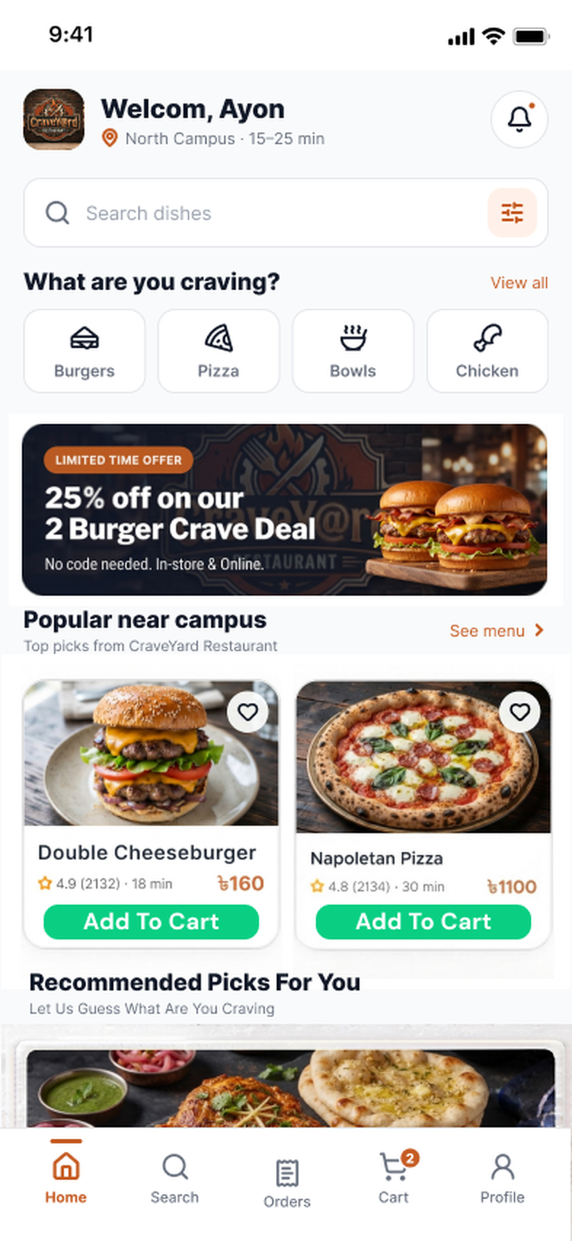
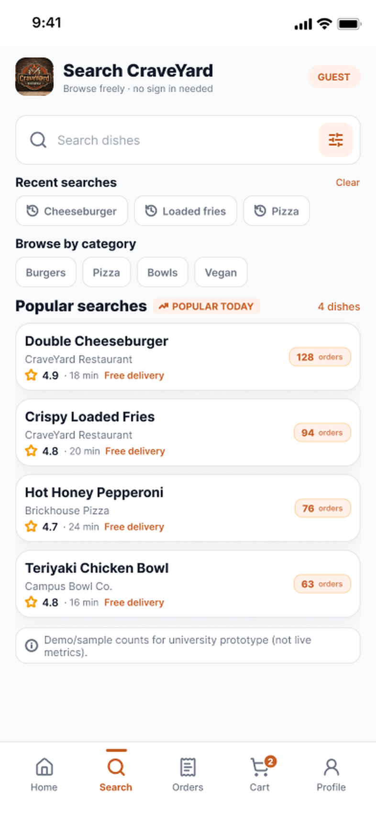
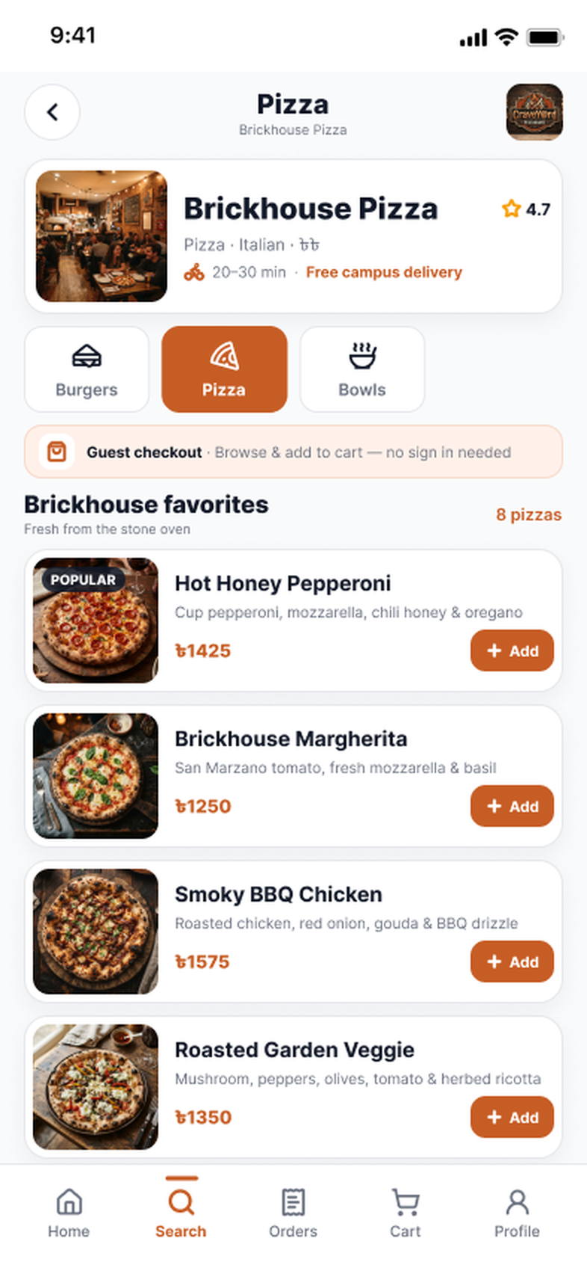
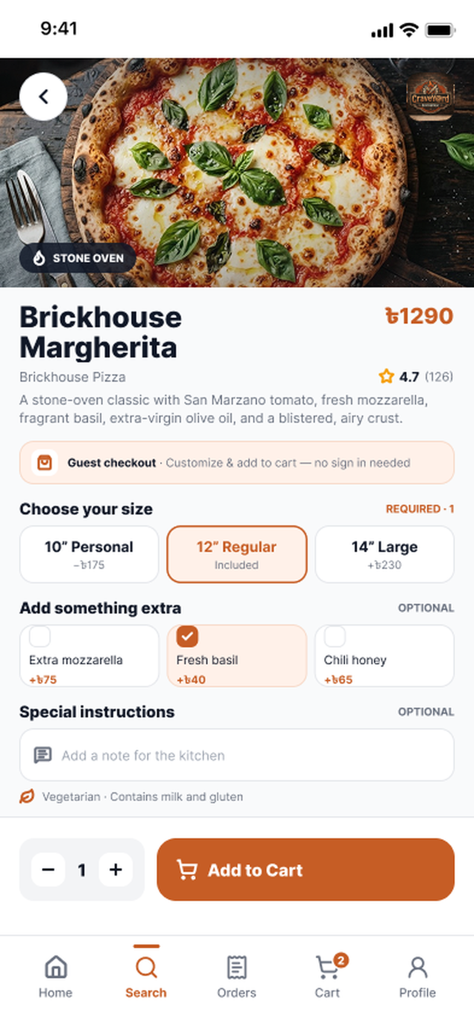
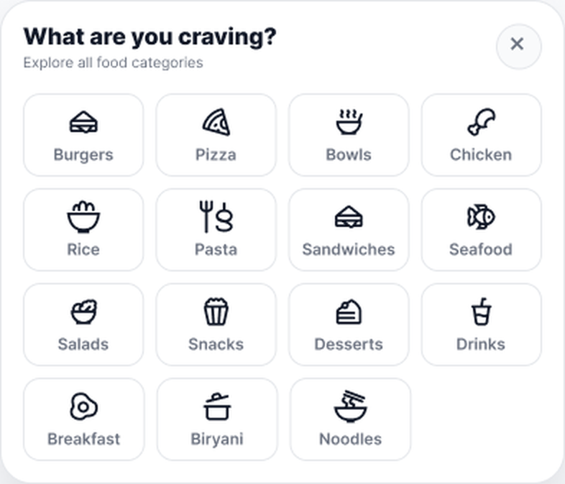
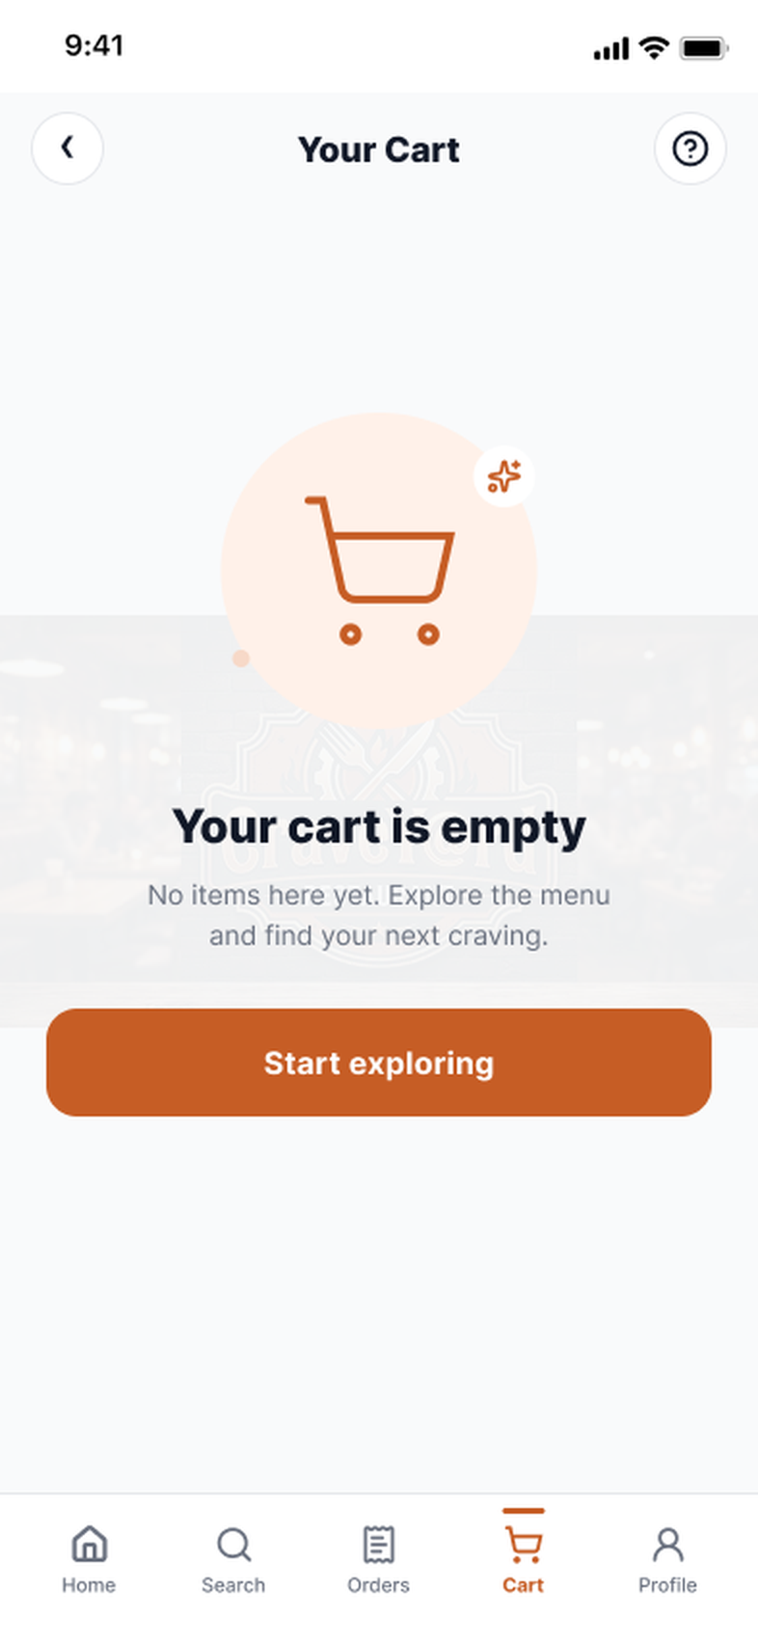
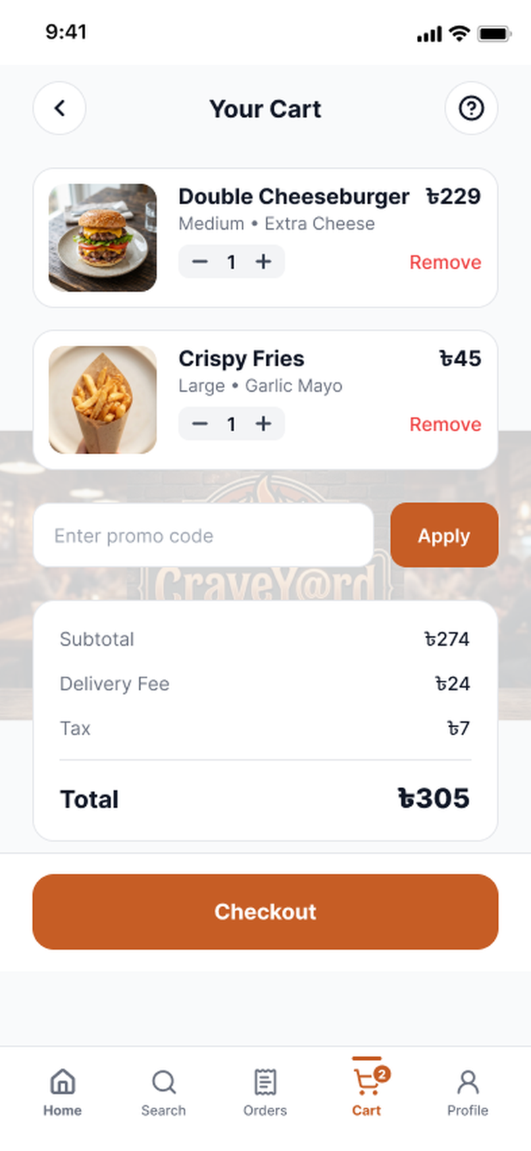
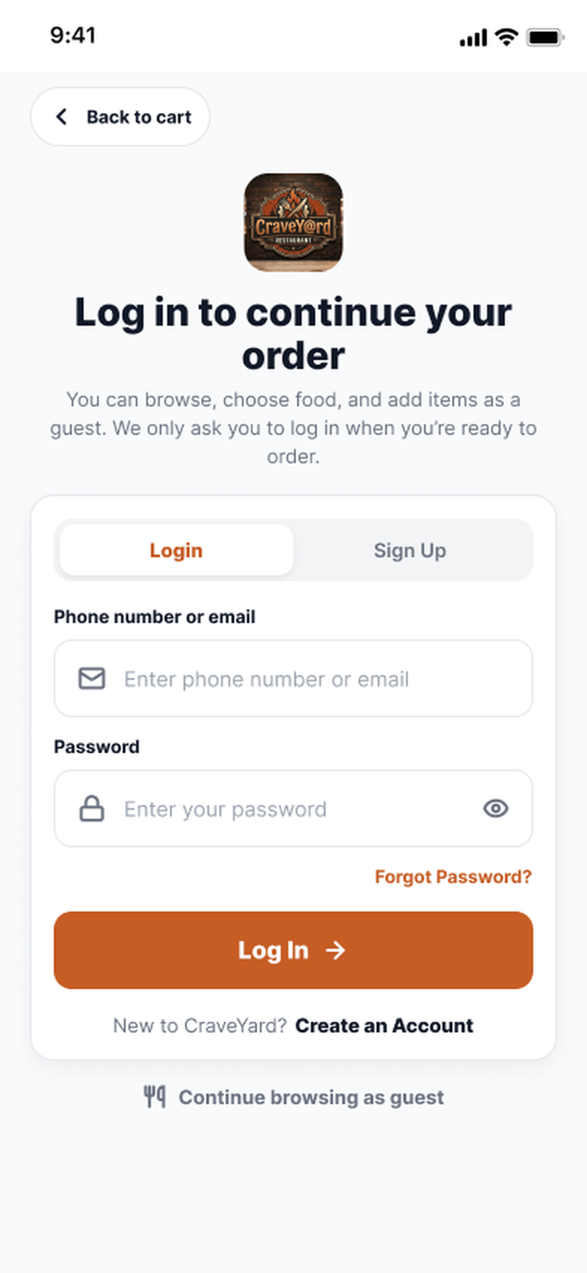
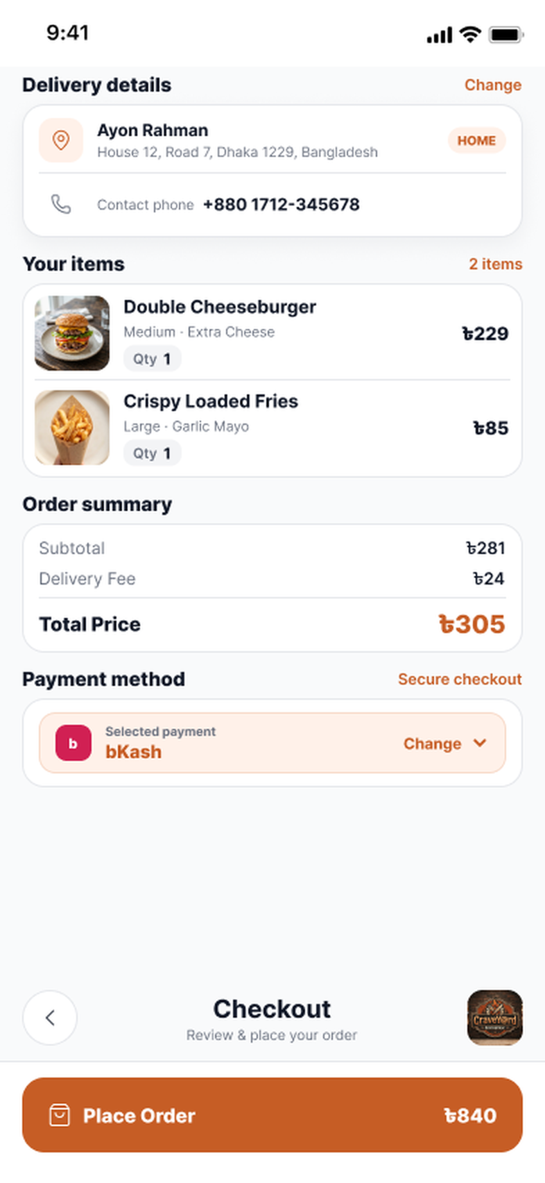
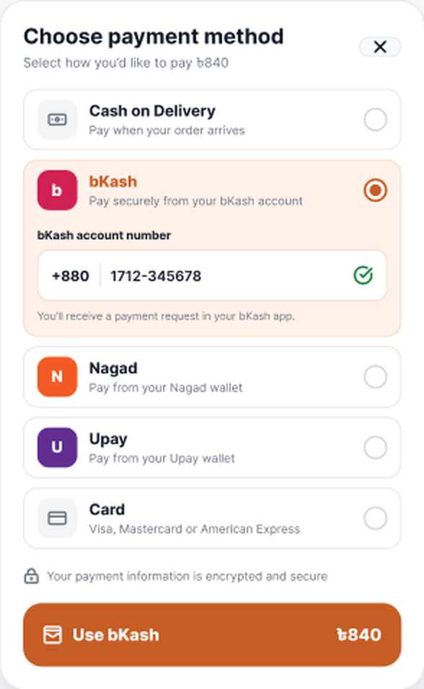
PART 2 • FUYAD • 1 OF 2
Workflow / Prototype in a Glimpse
From the home screen to payment: how a guest or student moves through the prototype. Continues on the next slide.
BROWSE & CUSTOMIZE
View all
Pick a category
Open restaurant
Select a dish
Home
Food categories
Search
Restaurant menu
Item details
CART & CHECKOUT
Add to Cart
Remove items
Checkout
Log in or guest
Change payment
Empty cart
Cart
Login or guest
Checkout
Payment method
Notes:
A quick map of the first half of the prototype. The arrows show which button or action leads to the next screen. Browsing and cart building work for guests; login is only asked at checkout. The empty cart is the state after removing items.

Slide 2
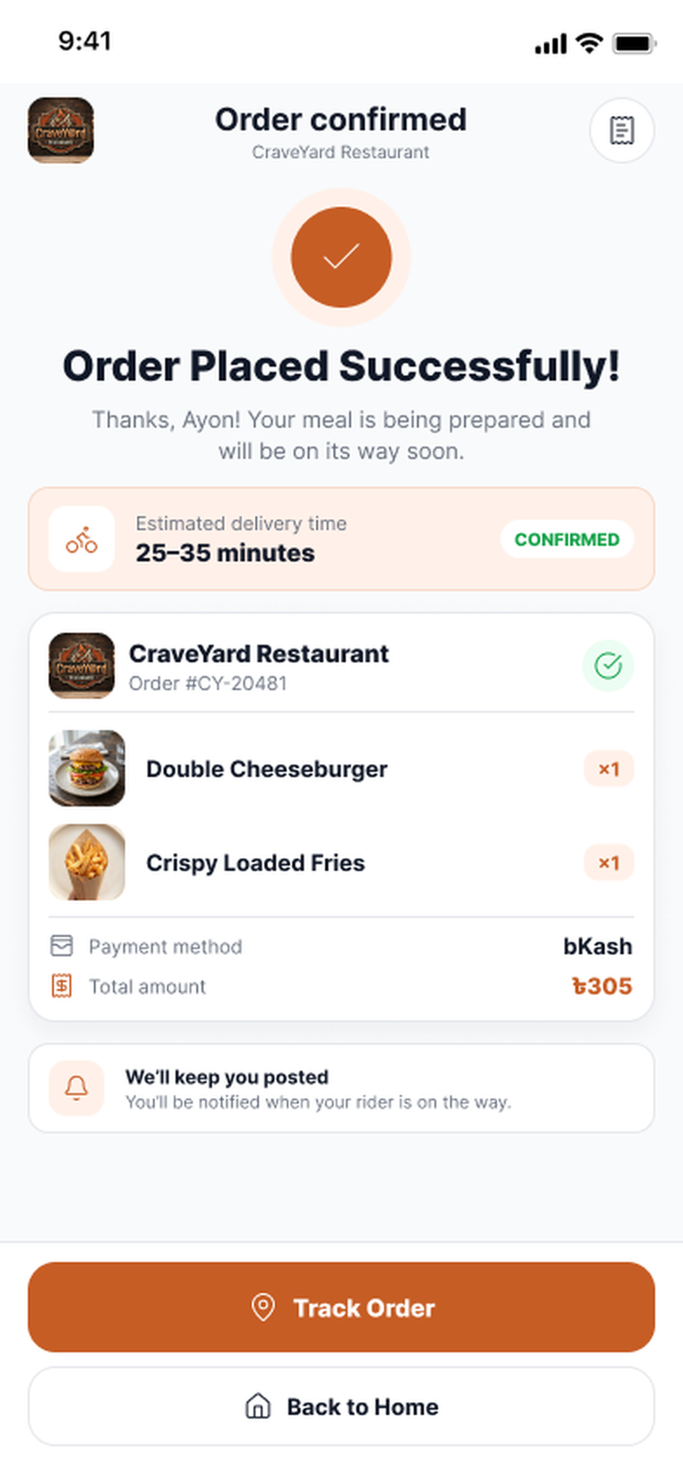
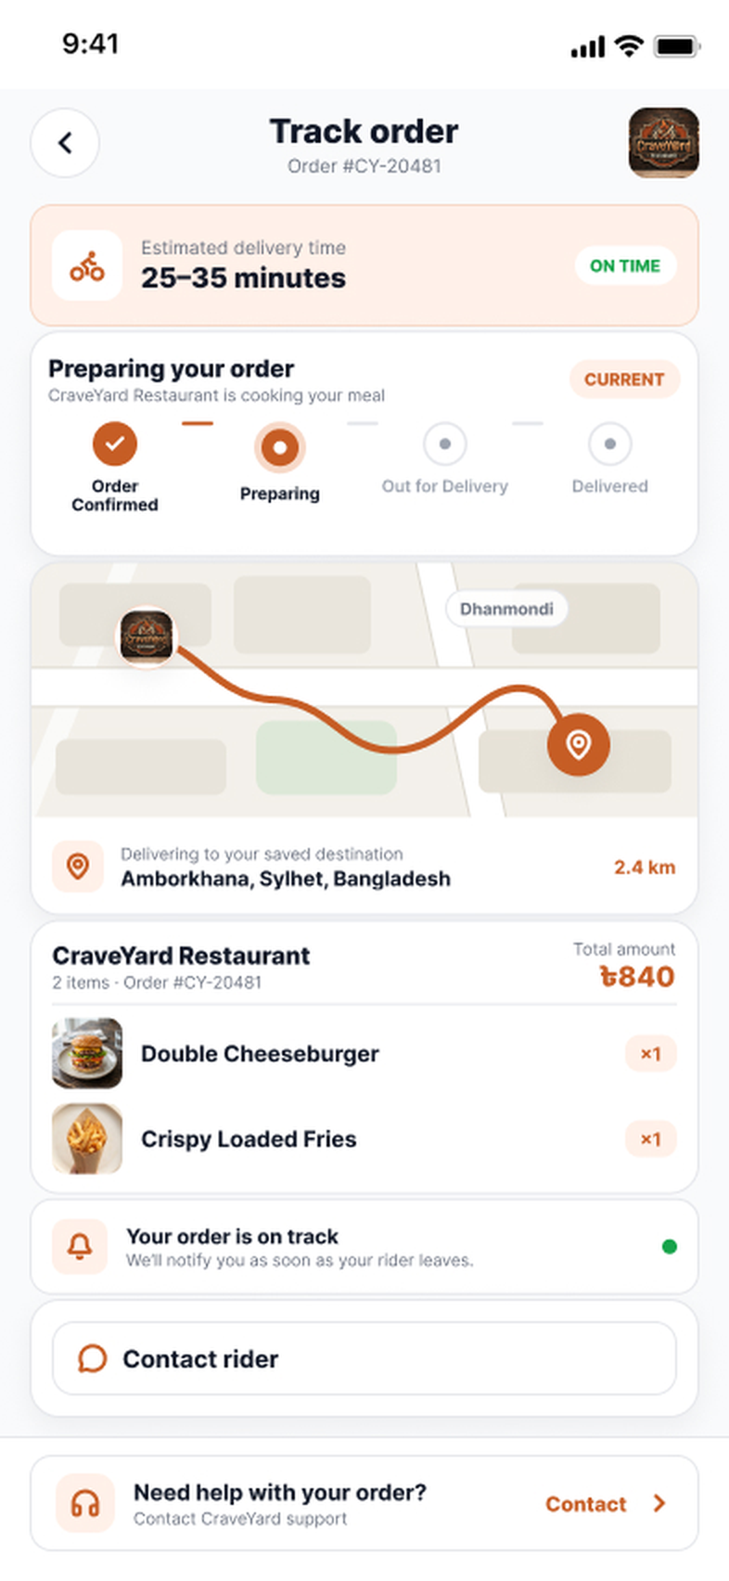
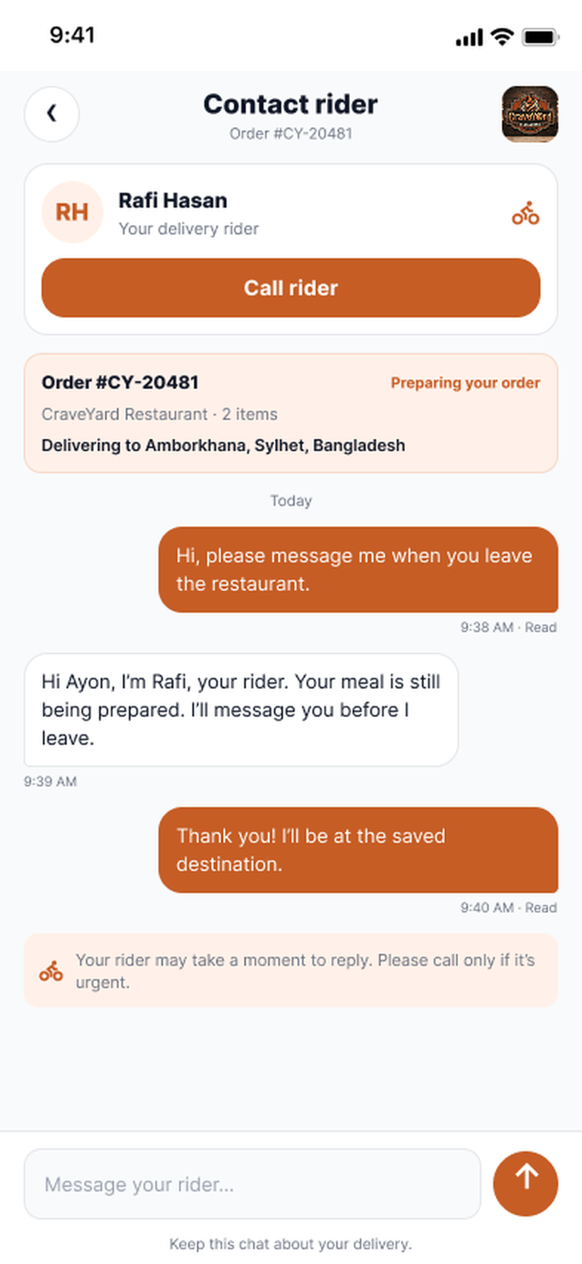
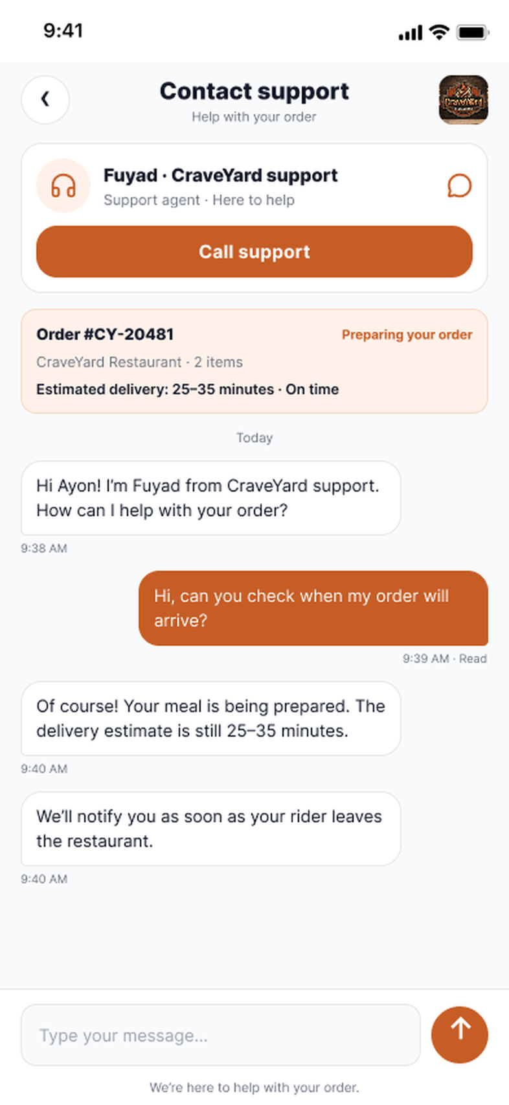
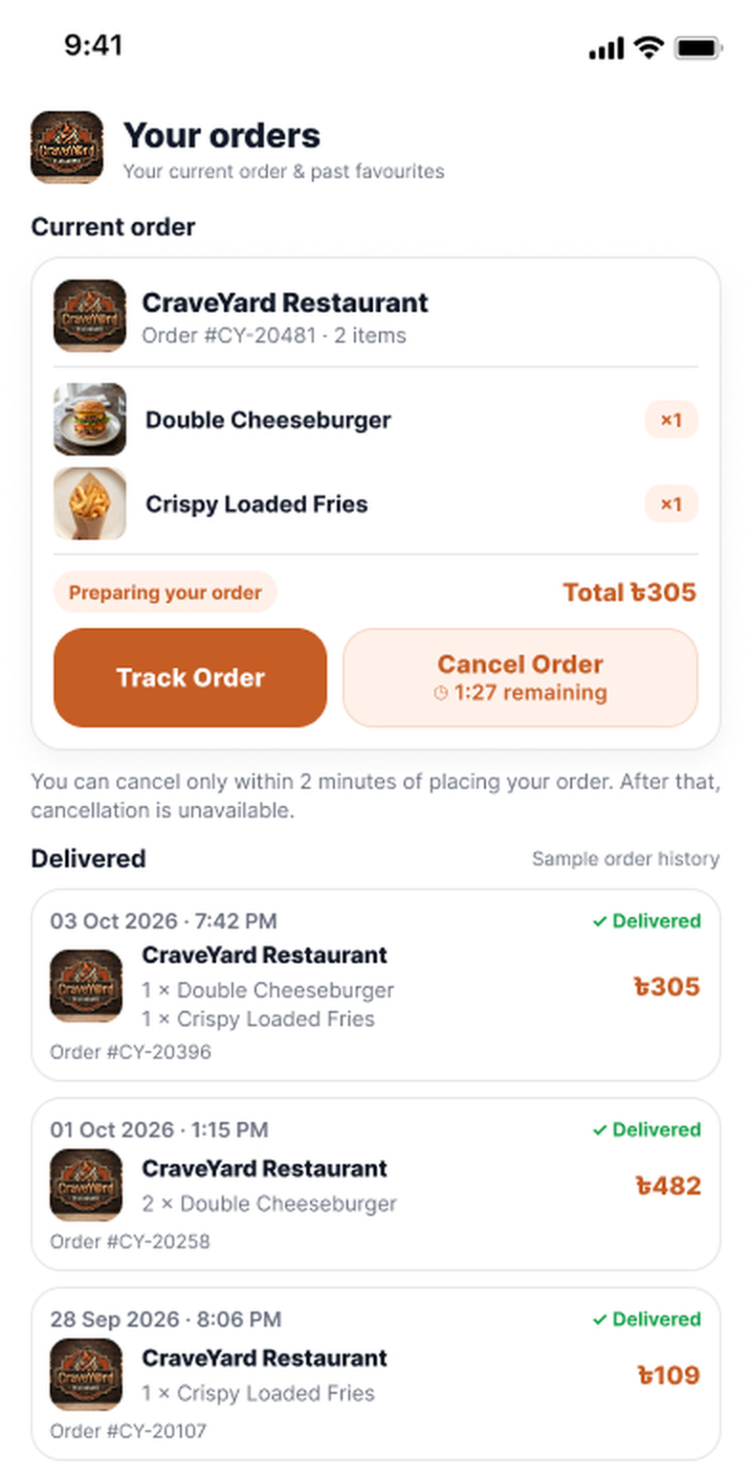
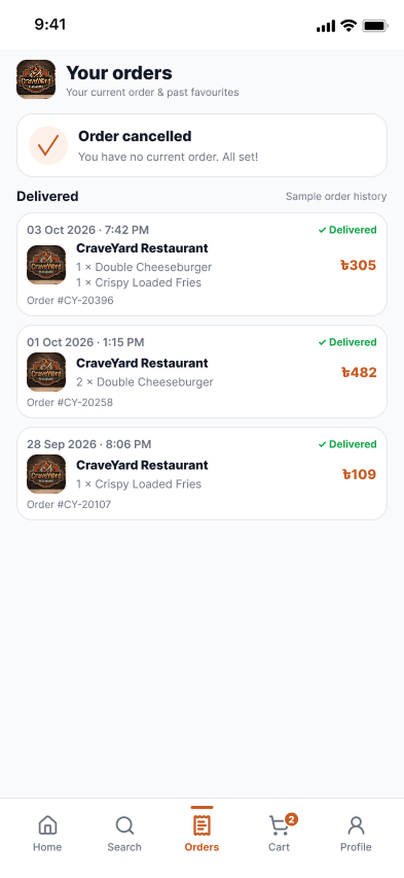
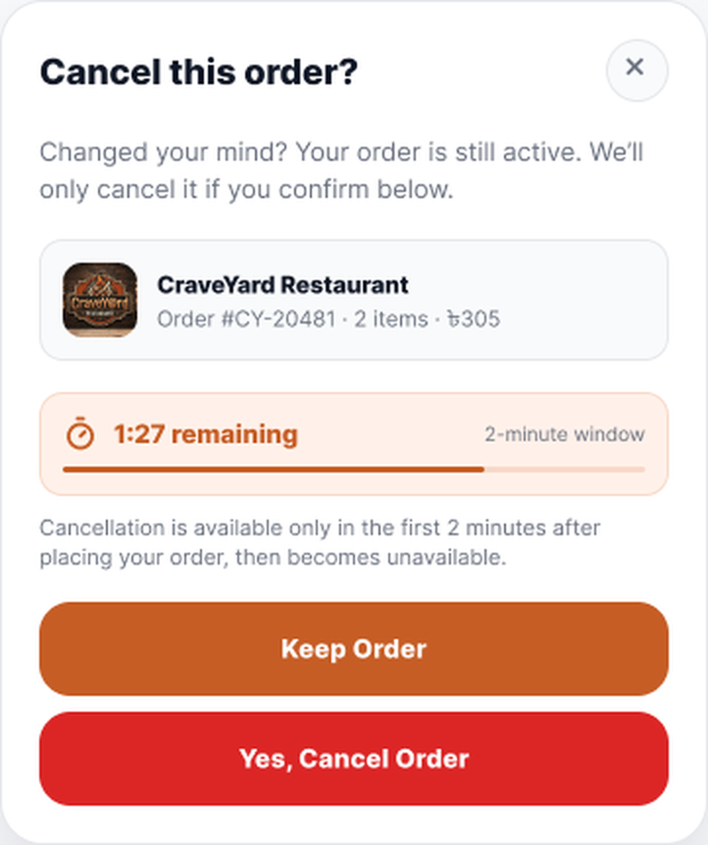
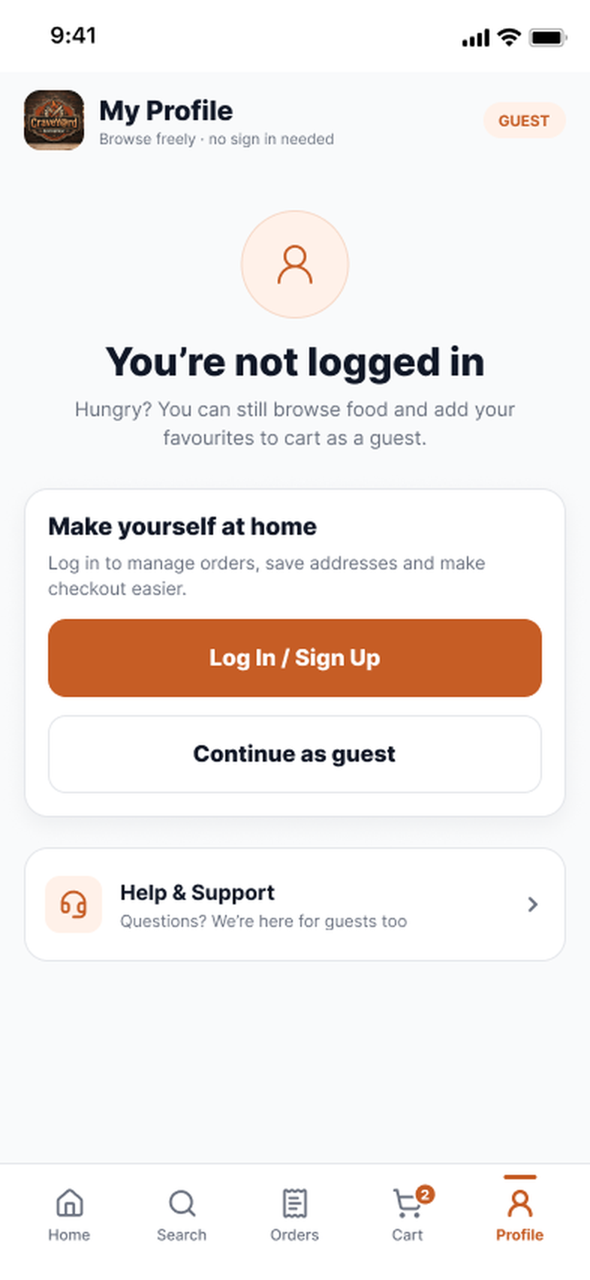
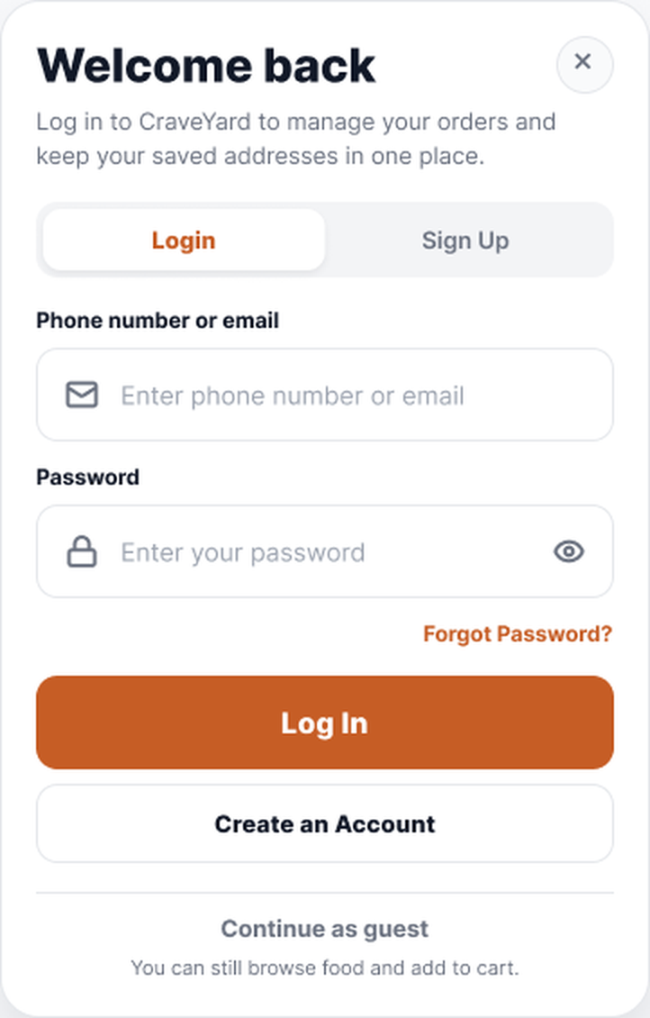
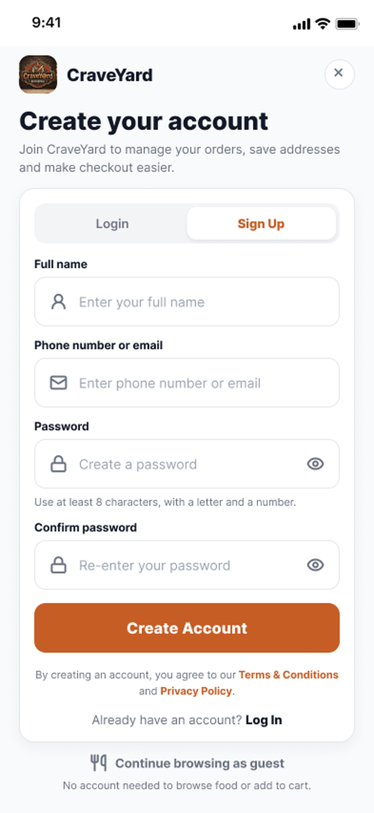
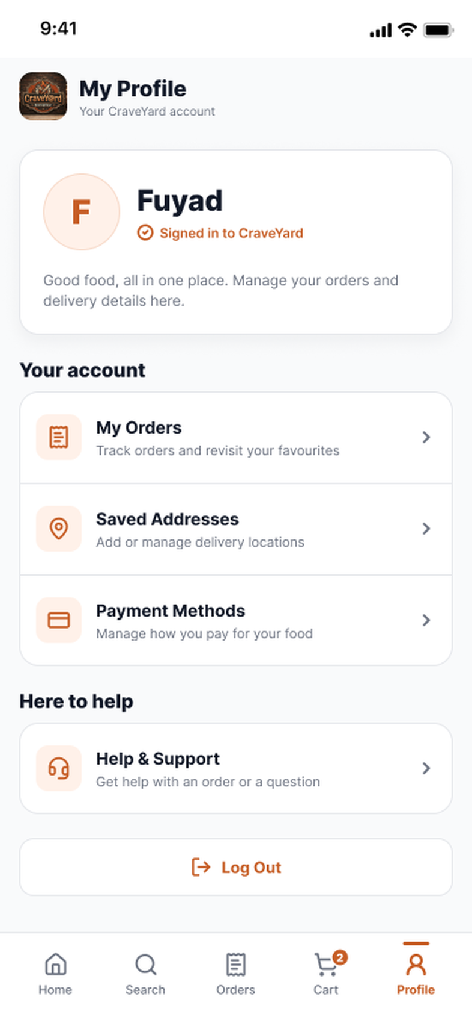
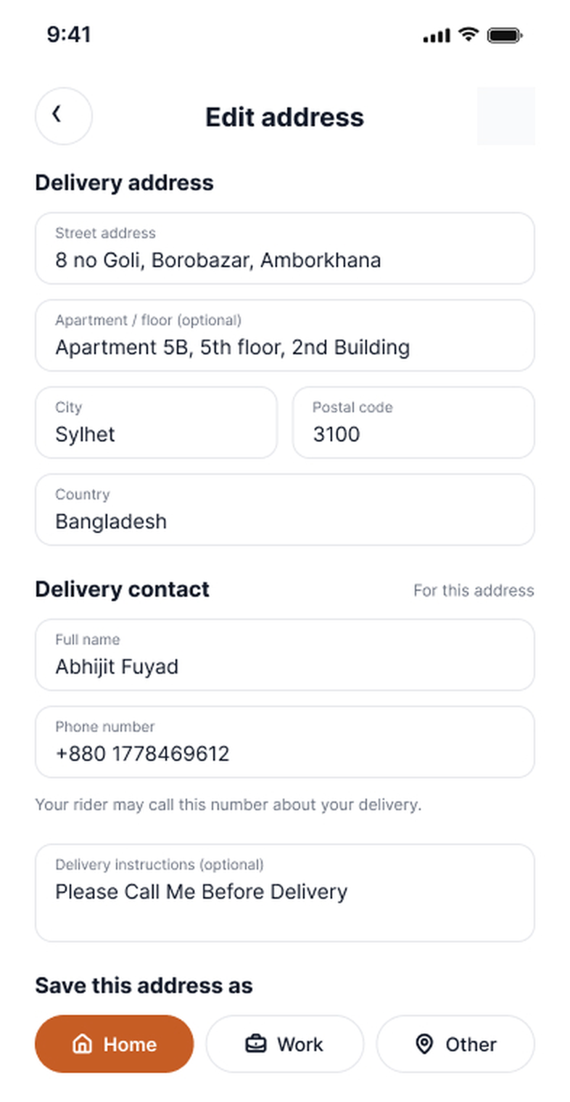
PART 2 • FUYAD • 2 OF 2
Workflow / Prototype in a Glimpse
After Place Order: confirmation, tracking, support and cancellation, then the account screens.
TRACK & CONTACT
Need help?
CANCEL WINDOW
Track Order
Contact rider
Cancel
Confirm
Order confirmed
Track order
Contact rider
Contact support
Current order
Cancel this order?
Order cancelled
ACCOUNT
Log In / Sign Up
Create an Account
Create Account
Saved Addresses
Profile (guest)
Log in popup
Sign up
Profile (logged in)
Edit address
Notes:
Second half of the prototype. After placing an order the student sees a confirmation, can track the order and contact the rider or support, or cancel within the 2-minute window. The bottom row shows the account path from guest profile to login or sign-up, and then saved addresses.

